Slide 1


Group 16: Polyp Detection System
Internal Advisor: Ms. Nida Khalil
Zeeshan (GL)
2017-SE-106
Syyeda Dua Raza
2017-SE-097
Shahab Yunus
2017-SE-122
Zeeshan Amir Khan
2017-SE-108

Slide 2


Slide 3
Exero

Slide 4
Exero
UI/UX Creative Design
UI Development
ML Development
Presenting: Zeeshan (GL)
2017-SE-106
Slide
1
Notes:
I have worked upon these area throughout the project. And, I am going to explain what I did.

Slide 5
Exero
UI/UX Creative Design
Identifying with the group, the key UI problems and brainstorming the possible solutions.
Making sure the design prototype adheres to the rules of efficient human computer interaction.
Exploring different fonts and color themes and choosing the best.
Slide
2
Notes:
As the Group Leader, I had the responsibility to get involved in the creative process and help the group members with their task. To make sure we achieved the best possible solution, we identified different problems related to UI and all the possible solutions [click]
I made sure the design prototype was adhering to the guidelines of human computer interaction. [click]
Exploring different creative options like fonts and themes and experimenting with the team to identify the best combinations. [next]

Slide 6
Exero
UI Development
PyQt5 Framework chosen due to its flexibility.
Translating the UI Prototype into a working application, using custom widgets.
Responsiveness
  Multi-threading
  Efficient code
Robust feature support
Slide
3
Notes:
To build our application, I chose the pyqt5 framework mainly because it provides lots of flexibility. [click]
The main task I had was to translate the UI prototype into a working application with the same behavior and characteristics, as expected by the designers while designing prototype. [click]
Making sure the application was responsive was a main goal and to achieve it, I had to write efficient code and make use of multithreading. [click]
Providing robust support for features was also of great concern of mine when developing the app.

Slide 7
Exero
ML Development
Selecting the dataset. We choose KVASIR-SEG which contains 1000 segmented images of polyps.
Processing the dataset.
Developing the basic script to train model on google colab.
Selecting the model architecture to train on. Single-Shot Detector (SSD) was chosen due to its ability to run in real time.
Slide
4
Notes:
Choosing the dataset was the first step. We chose mentioned dataset which contained 1000 images with the segmentation of polyps which was done by experts. [click]
The next step was to pre-process the dataset. [click]
After that, we developed a basic script to train the model on google colab. [click]
We selected SSD as the model architecture because of its ability to perform in real time. [click]
[next]

Slide 8
Exero
ML Development
(cont.)
Training the model with several different hyper parameters:
  10800 epochs with rmsProp as optimizer, dropout 90, autoaugment, learning rate set to 0.045, step 2, decayRate 94 resulted in accuracy of 86.1% and loss of 3.37
  12914 epochs, with rmsProp as optimizer, dropout 90, autoaugment, learning rate set to 0.045, step20, decayRate 94, gradClip2.0 resulted in accuracy of 88.7% and loss of 1.43
Slide
5
Notes:
I trained the model with the mentioned hyperparameters. I found that the learning rate of 0.045 was a bit high to get good accuracy and using gradient clipping resulted in a bit of improvement.
Several other models were trained by Shahab who will explain his findings next. [next]

Slide 9
Exero
ML Development
Software Quality Testing
Graphics
Presenting: Shahab Younus
2017-SE-122
Slide
6

Slide 10
Exero
ML Development
So we use SSD Inception v2 model and we were doing transfer learning. So I train 3 different models
  First we train the model with 25000 epochs and as a optimizer we use rmsProp, learning rate we use 0.004 with dropout 90. In that case we get 90% accuracy but we also get the loss of 1.17.
  In second model we use 15000 epochs with same optimizer that is rmsProp. Learning rate and dropout is same as in the first model but here we use augmentation, 2000 step and decay rate 95. This model gives us the 90 percent accuracy with loss 0.667. We use this model for our software.
Slide
7
Notes:
I trained the model with the mentioned hyperparameters. I found that the learning rate of 0.045 was a bit high to get good accuracy and using gradient clipping resulted in a bit of improvement.
Several other models were trained by Shahab who will explain his findings next. [next]

Slide 11
Exero
ML Development
(cont.)
  In third model we use 25000 epochs with different optimizer that is adam. Other parameters are same as the second model. And this gives us 78% accuracy and loss were 0.88.
Slide
8
Notes:
I trained the model with the mentioned hyperparameters. I found that the learning rate of 0.045 was a bit high to get good accuracy and using gradient clipping resulted in a bit of improvement.
Several other models were trained by Shahab who will explain his findings next. [next]

Slide 12
Exero
Software Testing
So here we were doing manual testing and there were some issues with our software.
Functional Bugs
  When we start the-pre recorded video and at some instance when we pause it, the video frames were moving and will stop after some mili seconds.
  When we setup the whole program by changing the setting. This works fine but when we updated it then there were no changings occur so in that case we have to restart the program and then the setting changes.
Slide
9
Notes:
I trained the model with the mentioned hyperparameters. I found that the learning rate of 0.045 was a bit high to get good accuracy and using gradient clipping resulted in a bit of improvement.
Several other models were trained by Shahab who will explain his findings next. [next]

Slide 13
Exero
Software Testing
(cont.)
  Another important feature is book mark. Issue were when we save book marks, it saves according to the plan but when we open it, it crashes the whole application.
All the bugs have been fixed now.
Slide
10
Notes:
I trained the model with the mentioned hyperparameters. I found that the learning rate of 0.045 was a bit high to get good accuracy and using gradient clipping resulted in a bit of improvement.
Several other models were trained by Shahab who will explain his findings next. [next]

Slide 14
Exero
UI Designing
Videography
Documentation
Presenting: Syyeda Dua Raza
2017-SE-097
Slide
11

Slide 15

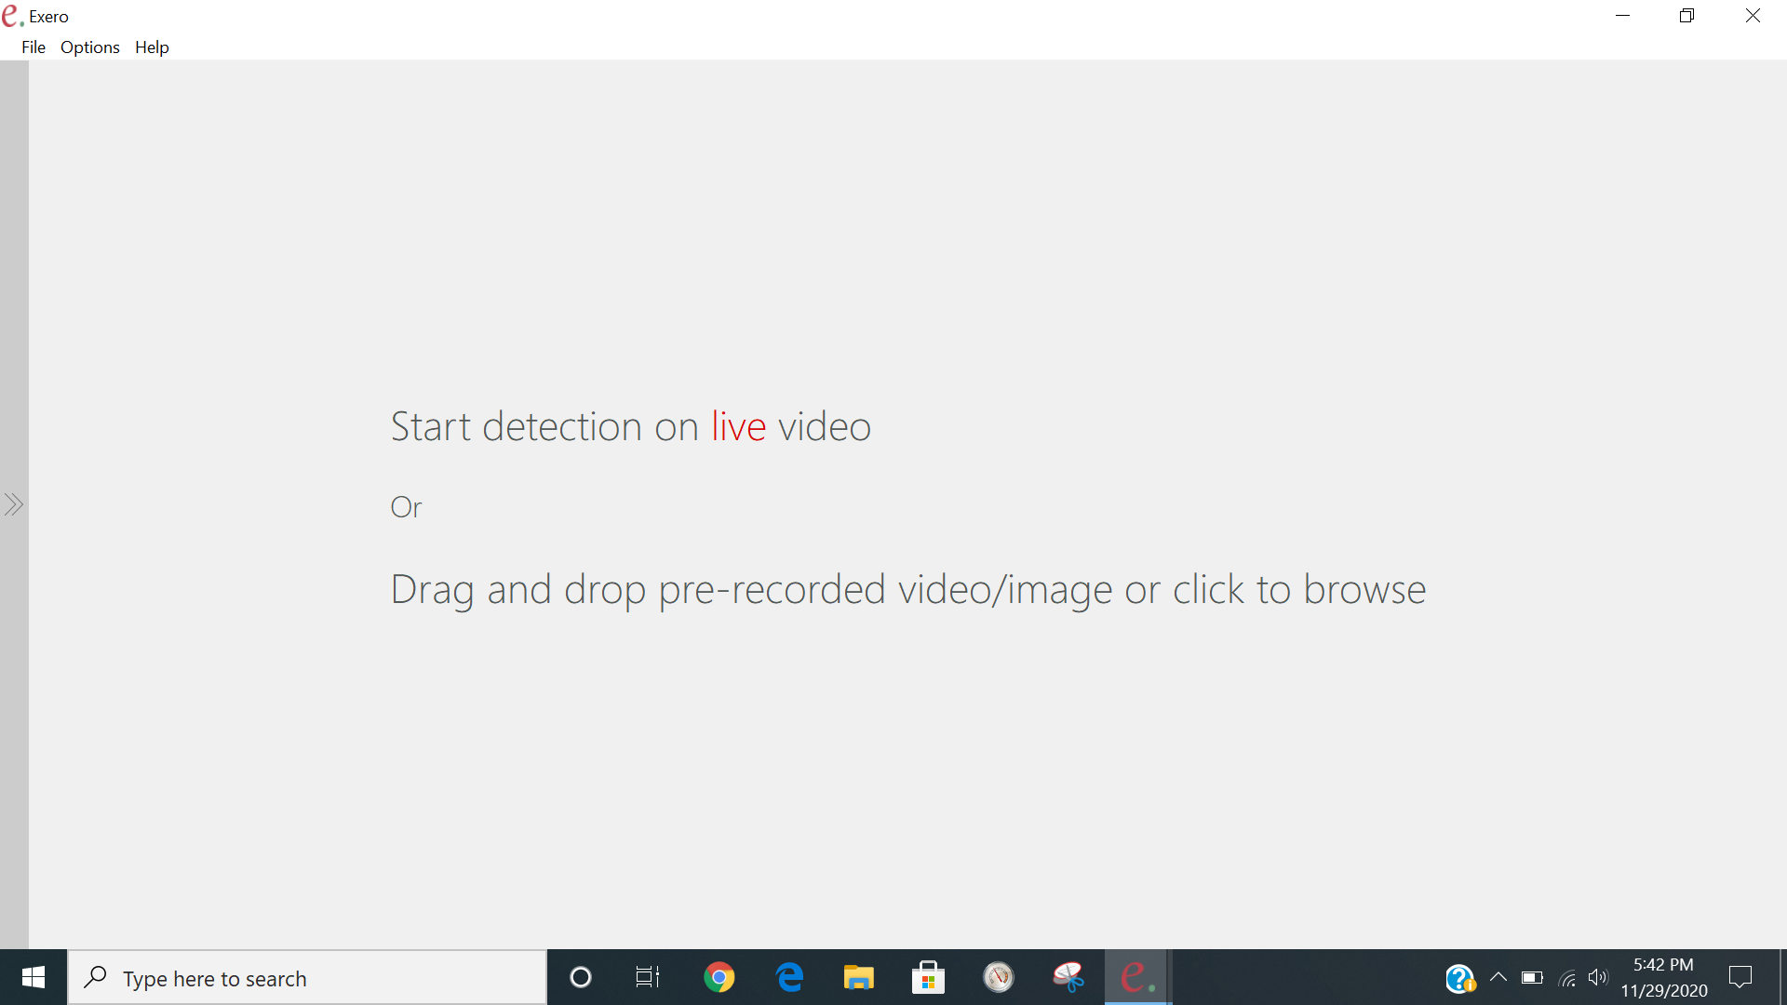
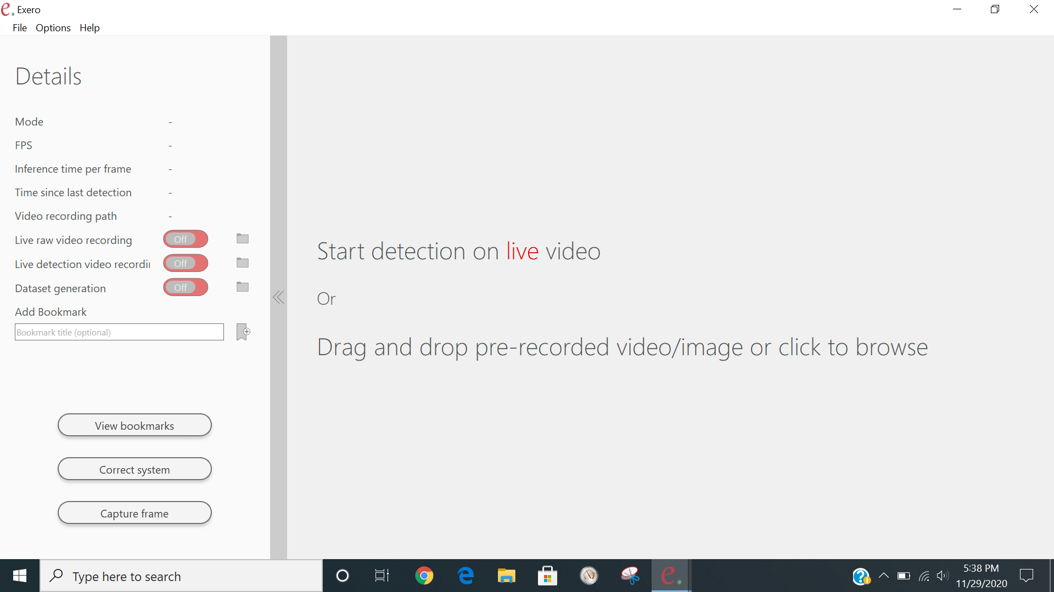
Exero
UI designing
The system UI is designed to make sure that color scheme does not cause eye fatigue in long term use.
The details panel shows information and houses quick to access features. It can be collapsed to hide the information and to focus on the detection on the main screen.
Slide
12

Slide 16
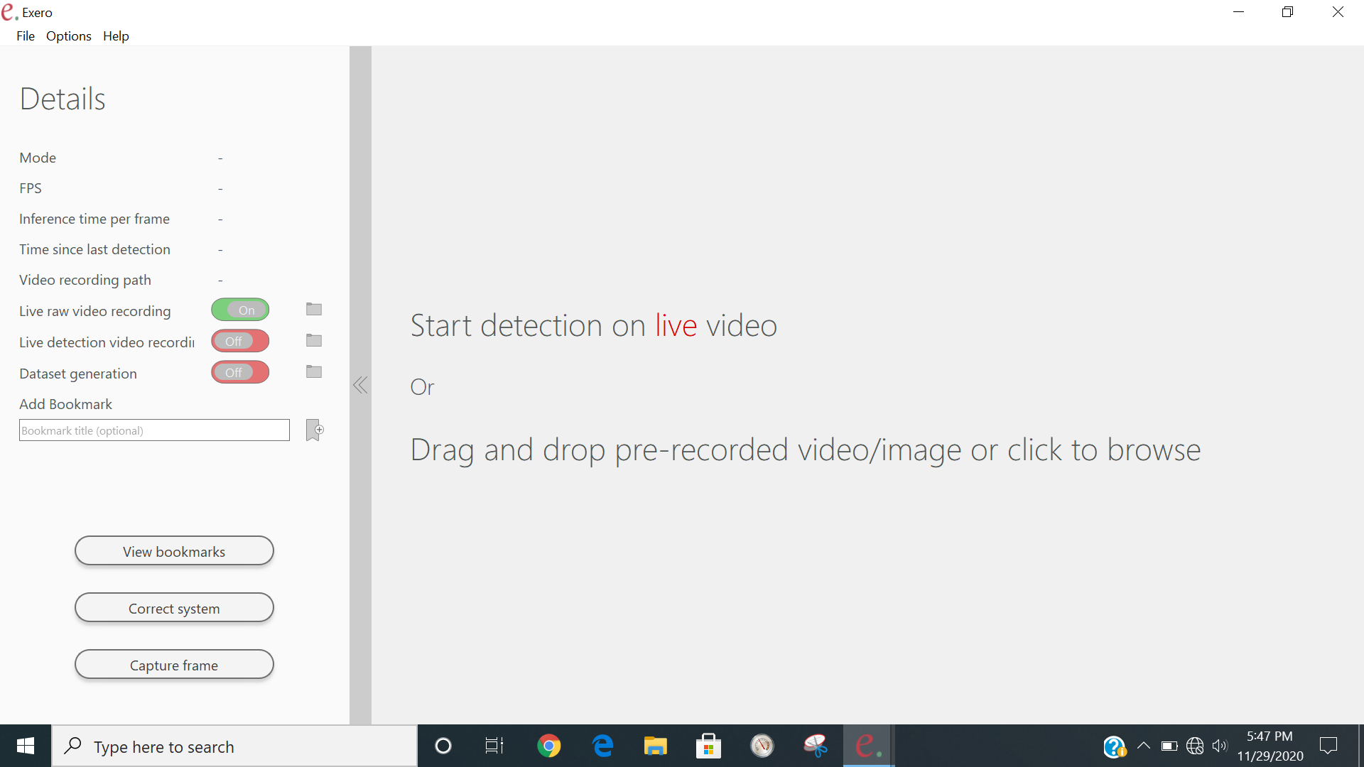
Exero
UI designing
(cont.)
For Saving Functionality, The toggle button also provides a visual indication of the current state of that functionality. The Folder-icon buttons allows to set the destination path for the file(s) being saved.
Live raw video recording saves the raw video as it is received without any modification, to the directory selected. The FPS of the recorded video is same as the source video, which is also displayed in the FPS label.
Slide
13

Slide 17
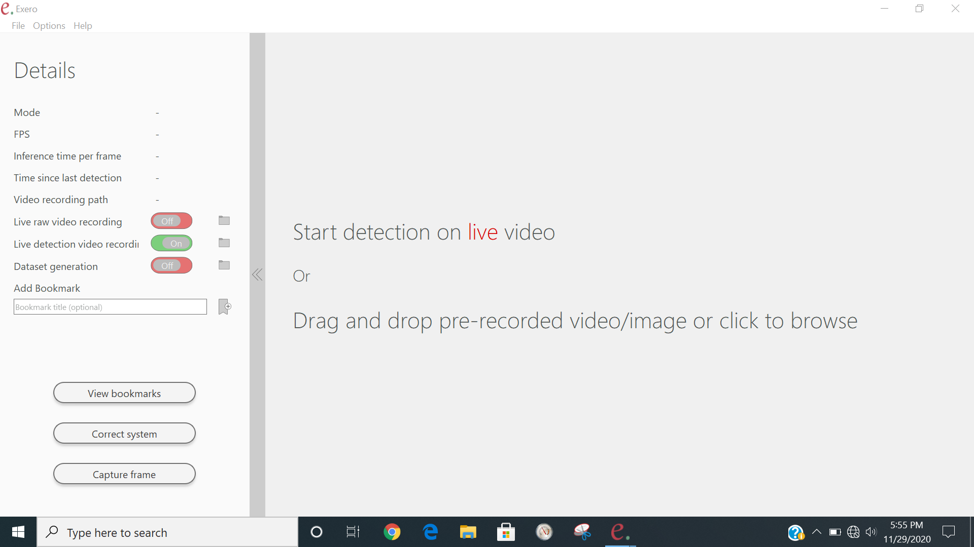

Exero
UI designing
(cont.)
Live detection video recording saves the video after detection as shown on the screen.
Dataset generation saves the raw frames after regular intervals, which can be set in the settings.
Slide
14

Slide 18
Exero
UI designing
(cont.)
User can save bookmark when pre recorded video is being used or in case of live video, the recording must be enabled.
Clicking on the bookmark item would jump the seekbar to that position. The bookmark file is stored in the same directory as the video file.
Correct System functionality provides option to user to save a frame with the result detection model provided.
Capture frame Functionality is like a screenshot. It captures the raw image and saves it to the database generation’s directory.
Slide
15

Slide 19
Exero
Testing
UI Design
Video Animation
Presenting: Zeeshan Amir Khan
2017-SE-108
Slide
16

Slide 20
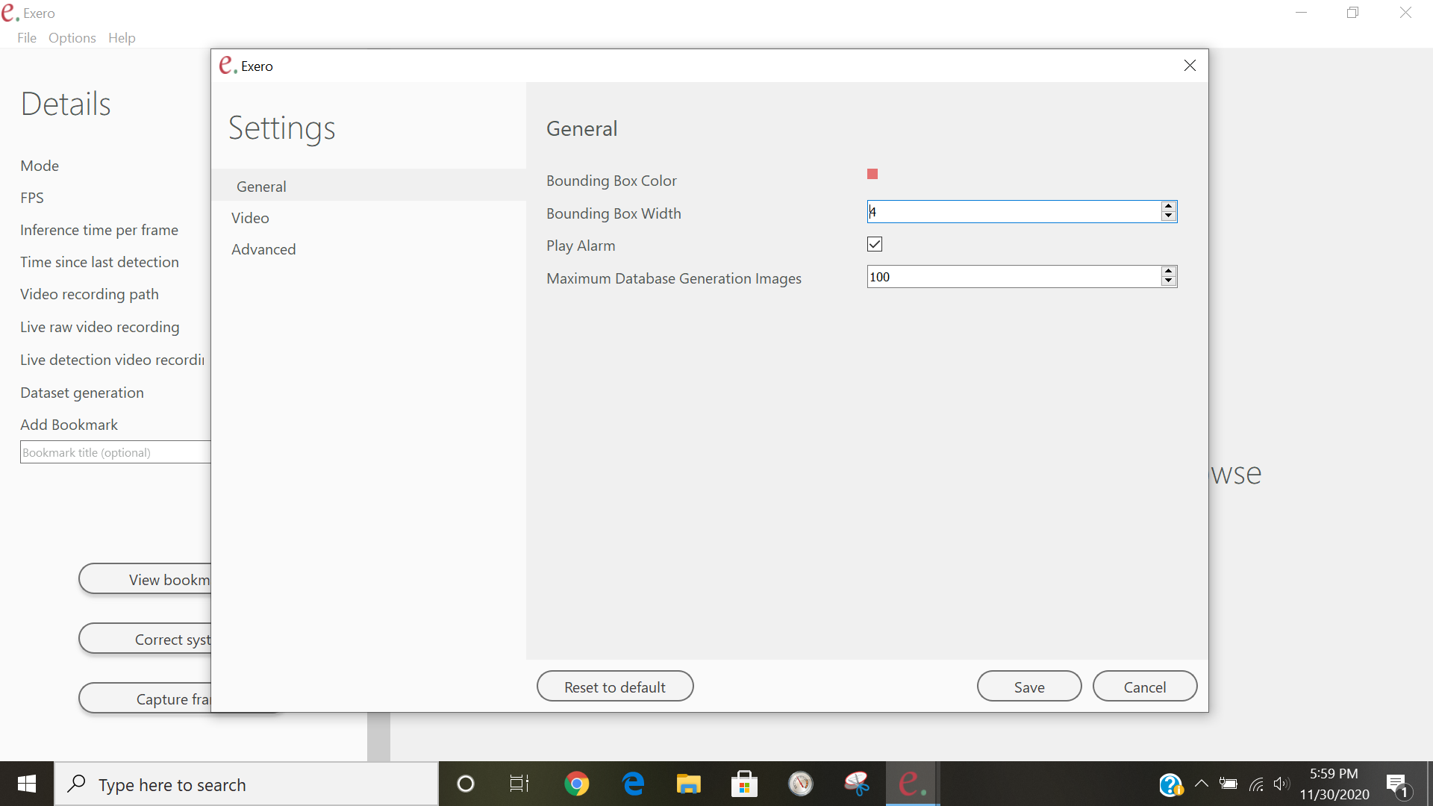
Exero
UI designing
This contains basic settings user might want to modify. These are:
  Bounding box color allow user to choose the color of the bounding box.
  Bounding box width allow user to choose the width of the bounding box’s border.
Slide
17

Slide 21
Exero
UI designing
(cont.)
  Play alarm allows user to enable or disable the alarm sound, which is played when polyp is detected.
  Maximum database generation images specifies the maximum amount of images that can be saved to prevent the complete utilization of disk space.
Slide
18

Slide 22
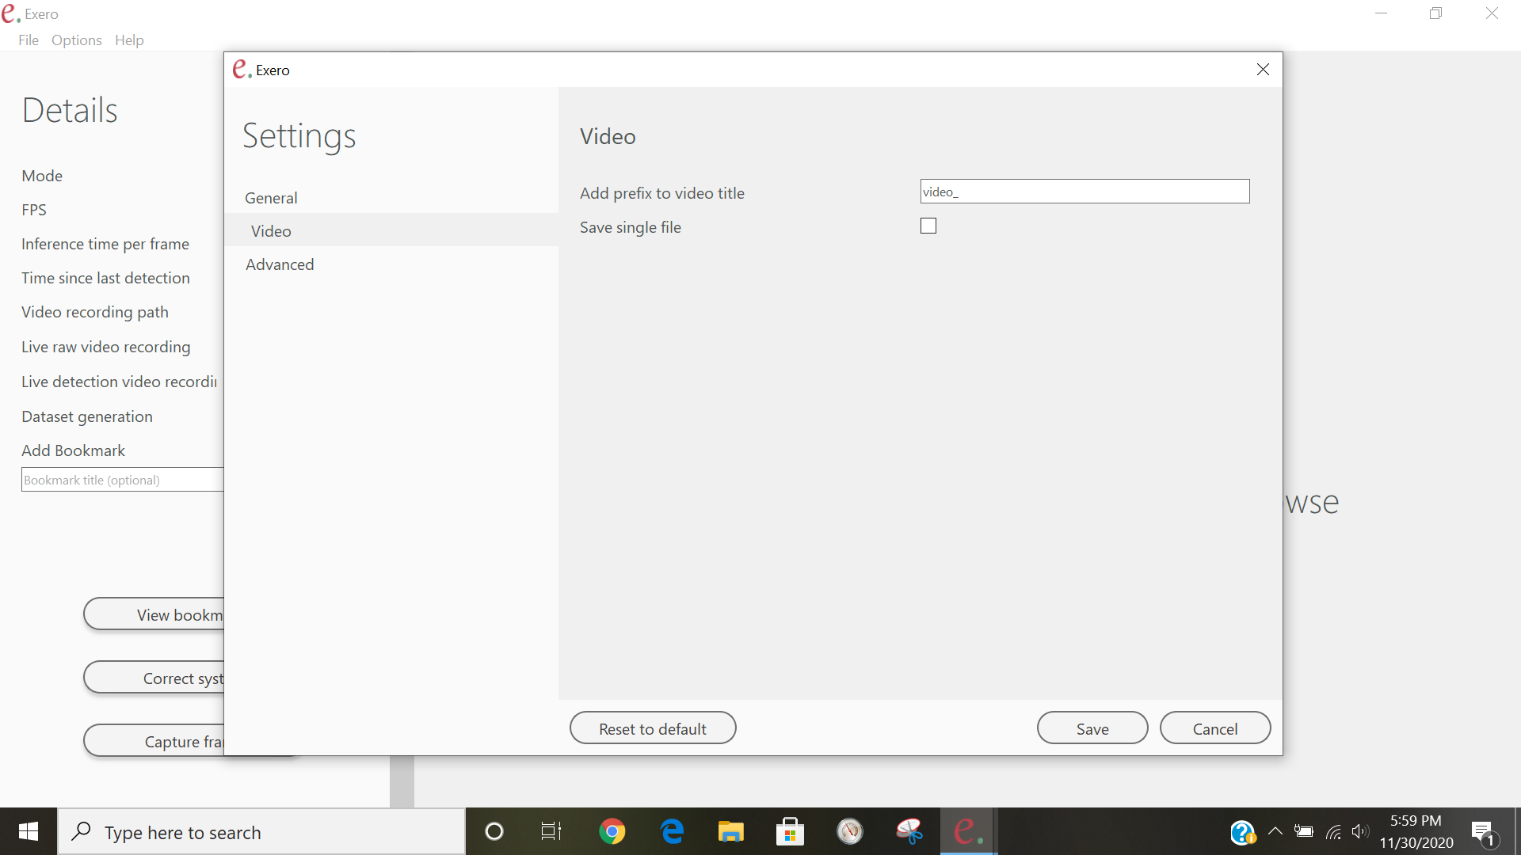
Exero
UI designing
(cont.)
This contains settings about video saving. These are:
  Add prefix to video title allows user to choose a prefix which would be used to save video file with the name having the provided suffix.
  Save single file allows user choose whether to continue saving to the same video file when recording is stopped and started again or make a new video file each time it happens.
Slide
19

Slide 23
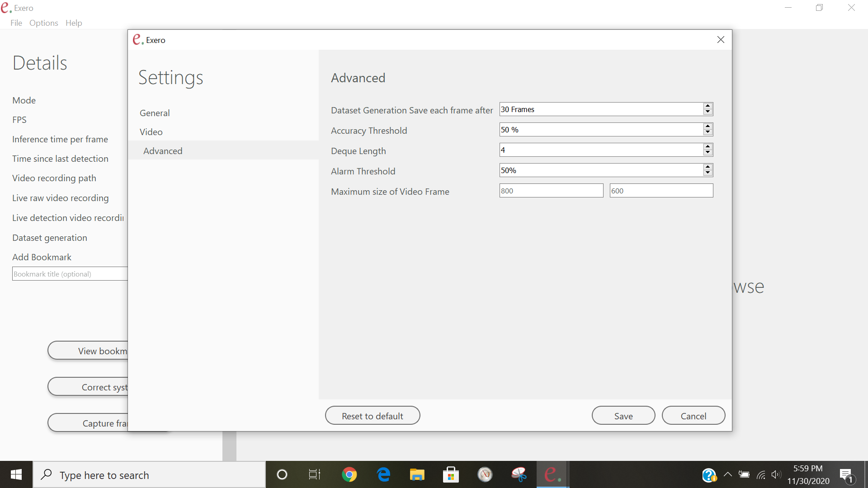
Exero
UI designing
(cont.)
  This contains advanced settings. These are:
    Dataset generation save each frame after option allow user to specify how many frames to skip before saving a frame when dataset generation is enabled.
Slide
20

Slide 24
Exero
UI designing
(cont.)
    Accuracy threshold is the threshold of the polyp detection.
    Deque Length is the length of array which contains the detection results of the previous n consecutive frames. The length of array n can be specified by user. This is used in alarm to make the alarm module more robust and impervious to model detection fluctuations.
Slide
21

Slide 25
Exero
UI designing
(cont.)
    Alarm threshold is the threshold used by the alarm module to decide if to play alarm or not. This is applied over the average of the alarm deque. This along with the deque length n specifies how much impervious it should be.
    Maximum size of video frame shows the size of the video port shown at the main screen.
Slide
22

Slide 26
Exero
UI designing
(cont.)
  Reset to default
    This option resets the values to the default values.
  Save
    This saves any changes made by user.
  Cancel
    This discards any unsaved changes and close the window.
Slide
23

Slide 27
Exero
Thank You
Slide
24

